Slide 1
Final Term Project Presentation
By Omar Shah

Slide 2
Dataset Overview
Transactions approved by the US Import-Export Office from 2007 to the 1st quarter of the 2025 Fiscal Year
Categorical features:
Identifier
Deal Number
Brokered
Country
Program
Policy Type
Decision Authority
Product Description
Term
Primary Applicant
Primary Lender
Applicant
Numerical Features:
Loan Amount Approved
Loan Amount Disbursed
Small Business Authorized Amount
One Engineered Feature:
Encoded Primary Exporter State

Slide 3
Data Cleaning
Data Cleaning using Dropna() and Fillna function
For some datasets, outliers were detected by calculating quantiles for some features
Outlier Removal
Data in the first and third quantiles were eliminated in this case

Slide 4
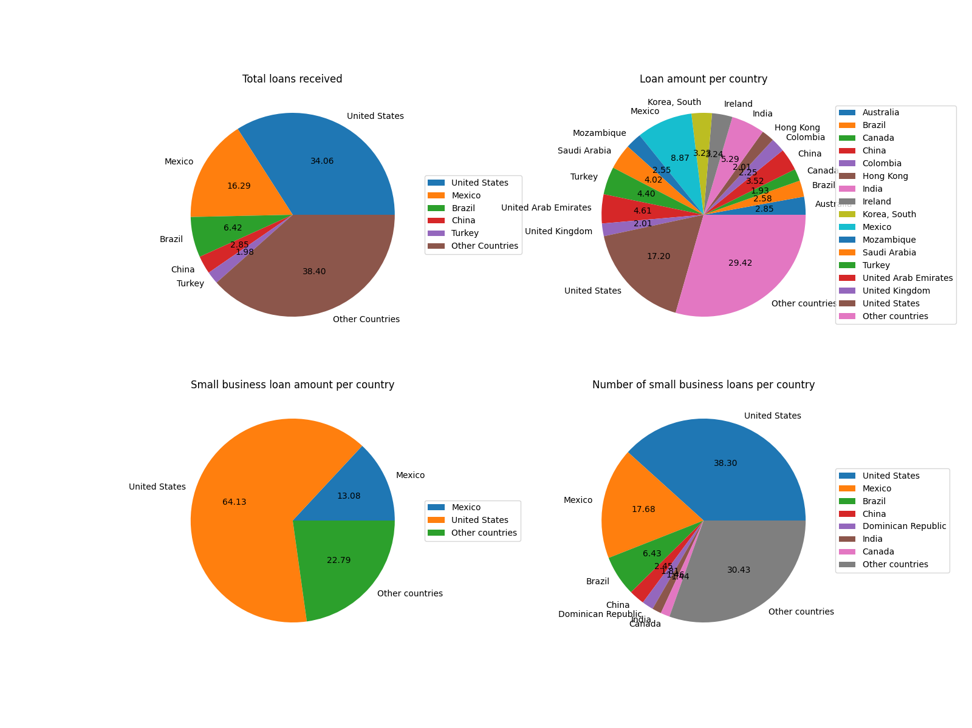
Pie Plot

Slide 5
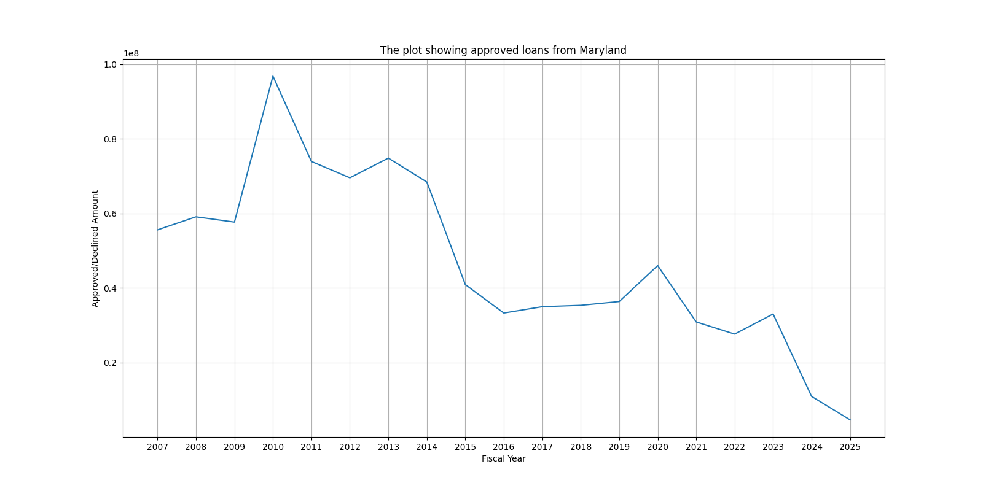
Line Plot

Slide 6
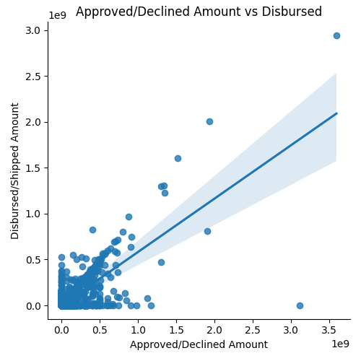
Scatter plot

Slide 7
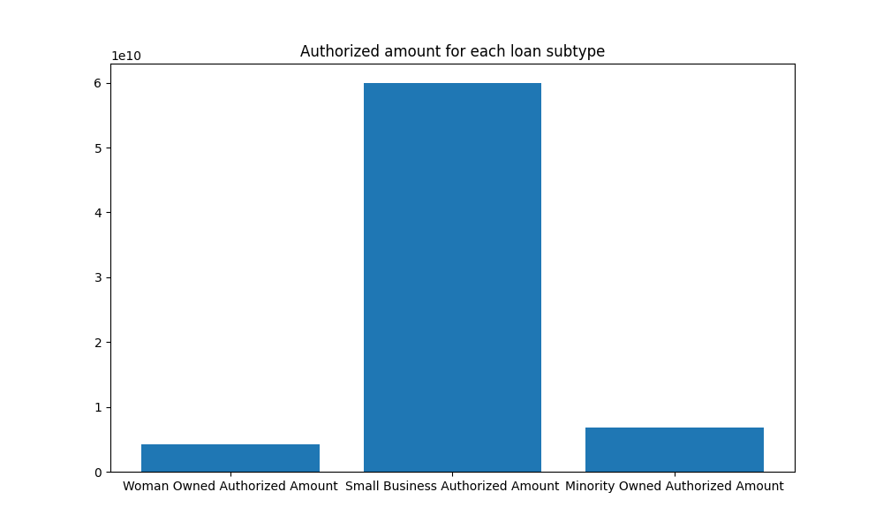
Bar plot

Slide 8
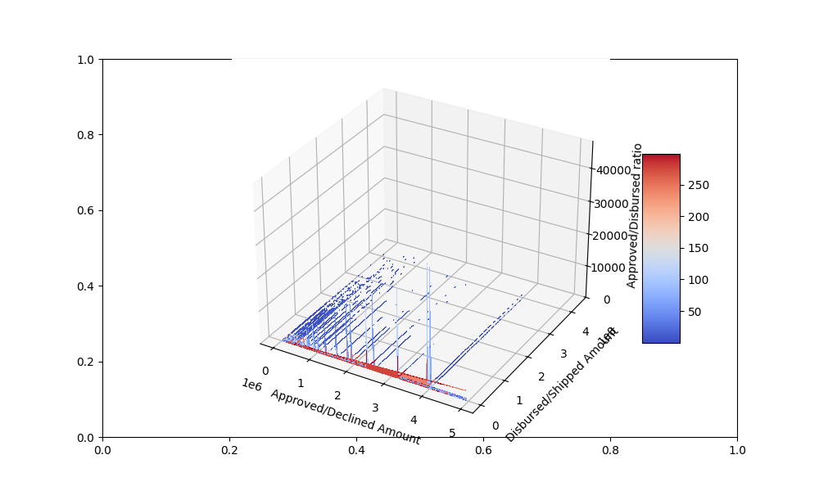
Surface plot

Slide 9
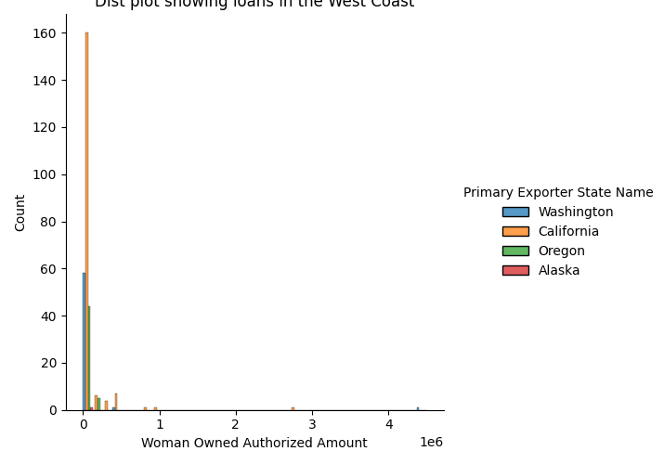
Dist plot

Slide 10
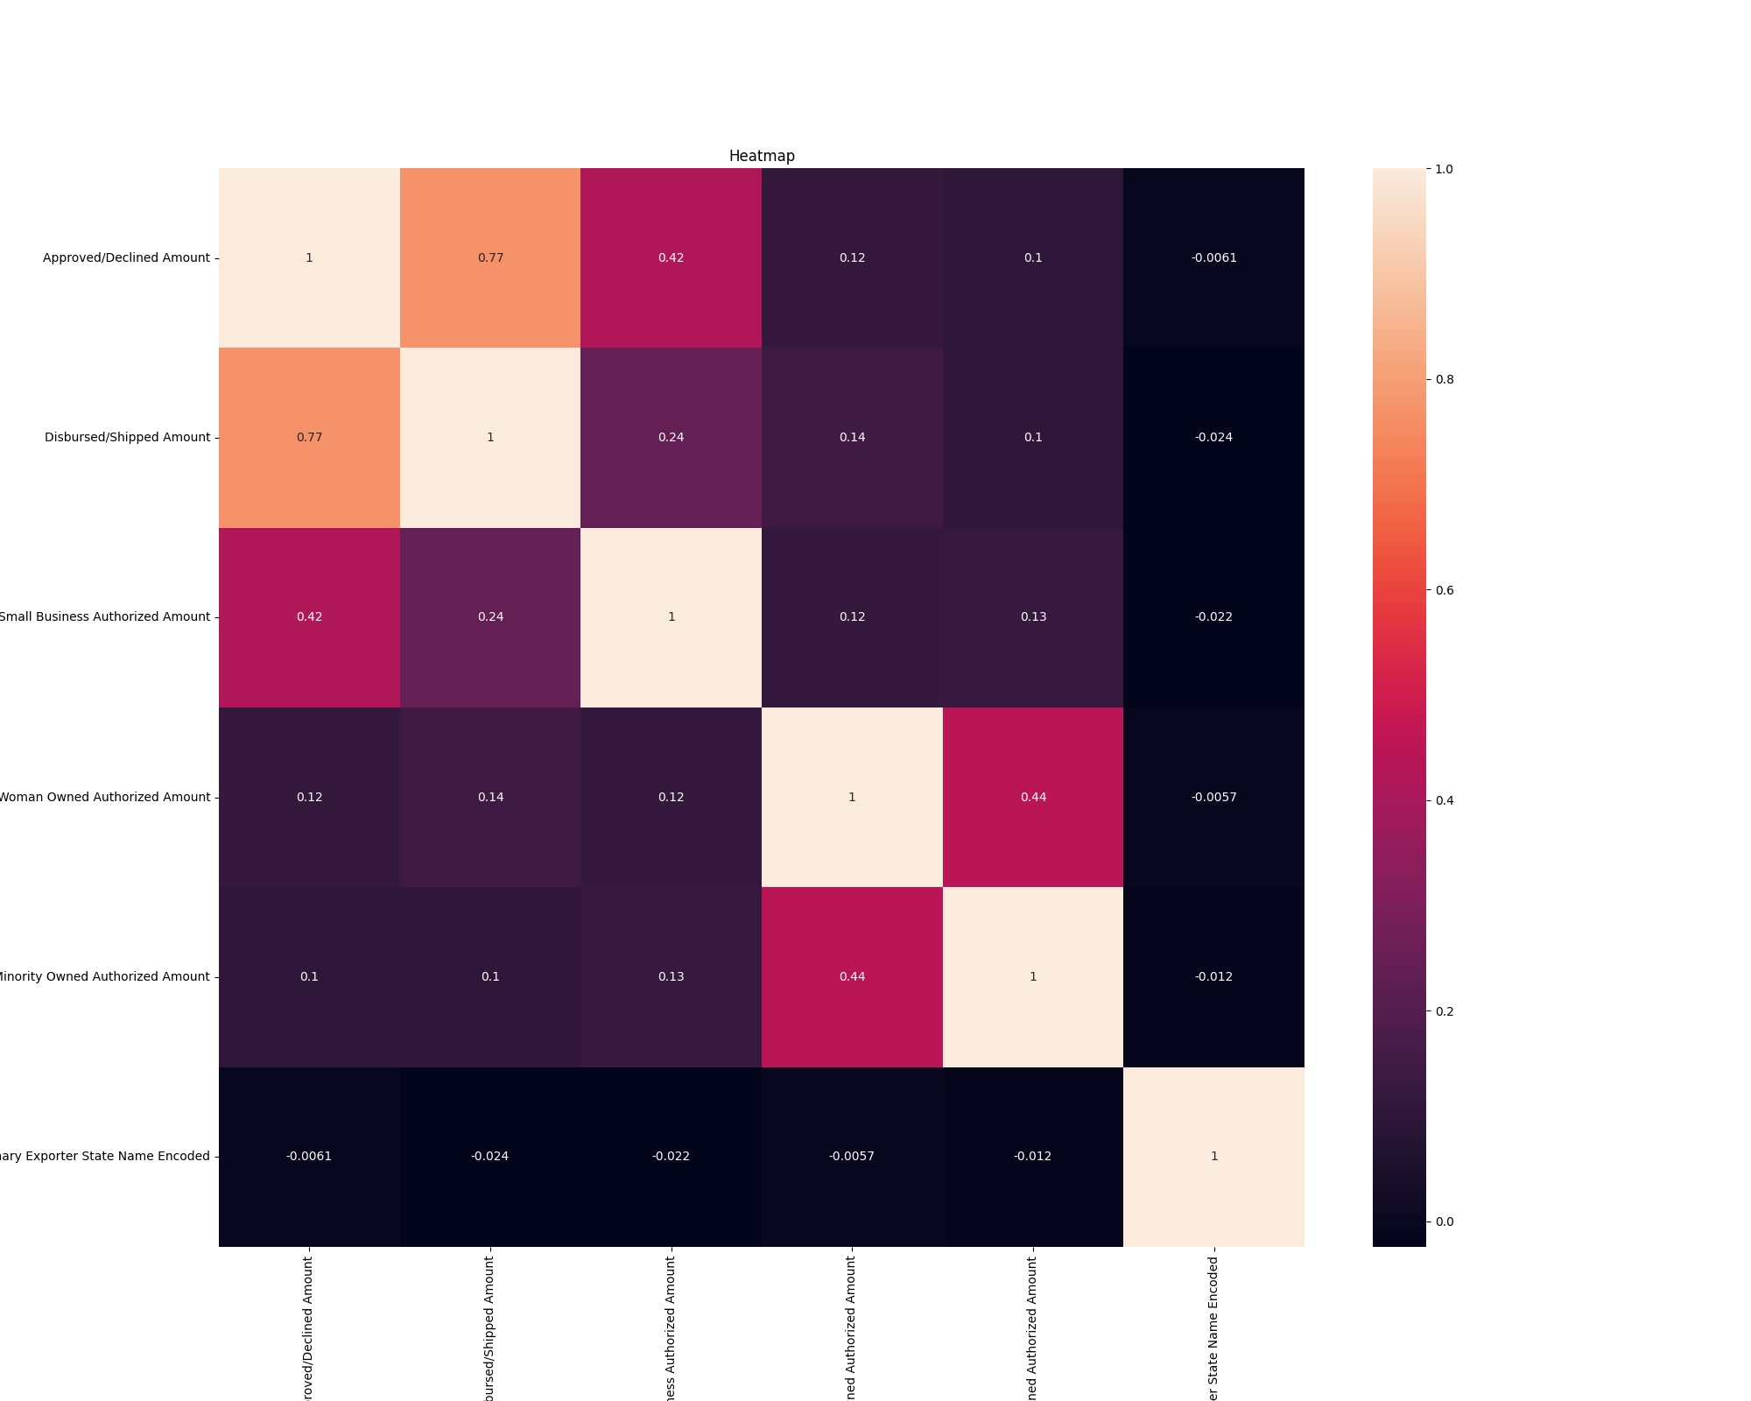
Heatmap

Slide 11
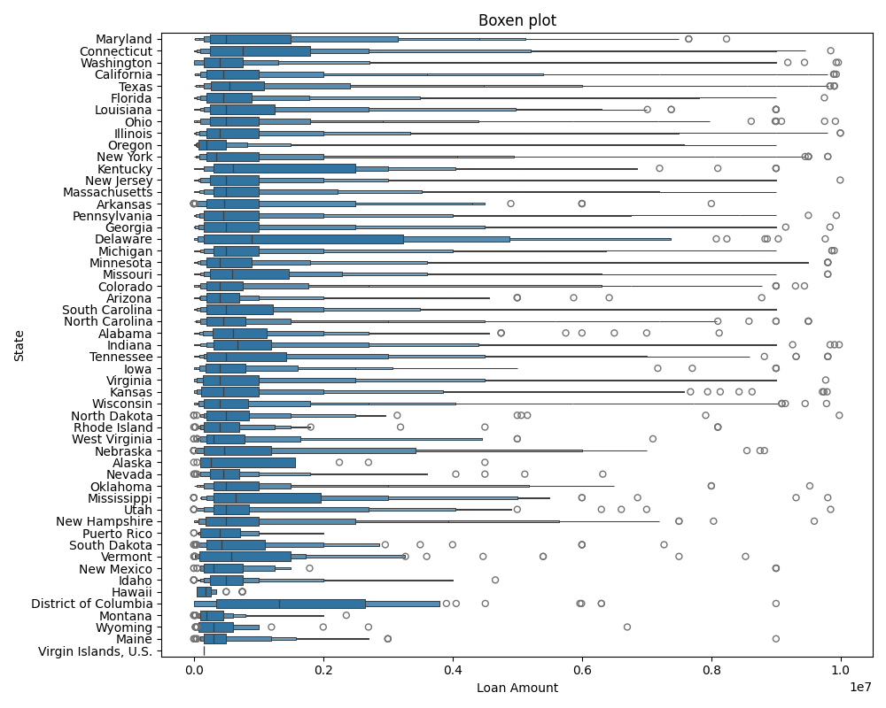
Multivariate Boxen plot

Slide 12
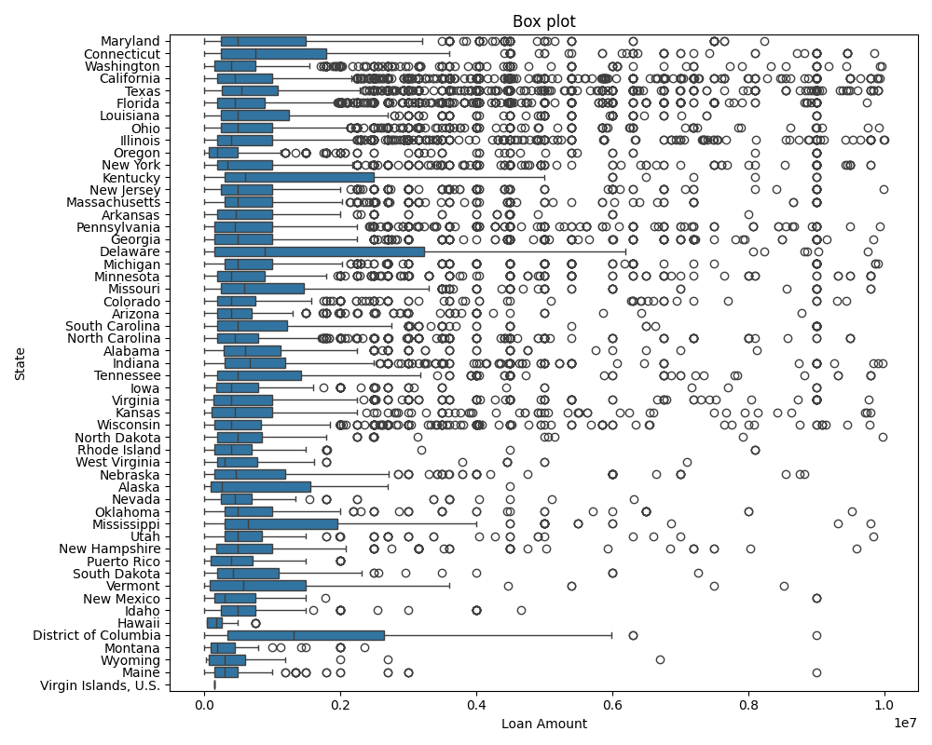
Box Plot

Slide 13
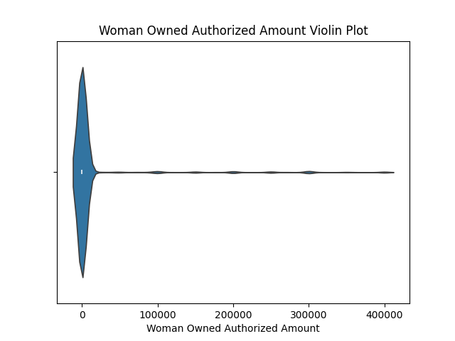
Violin

Slide 14
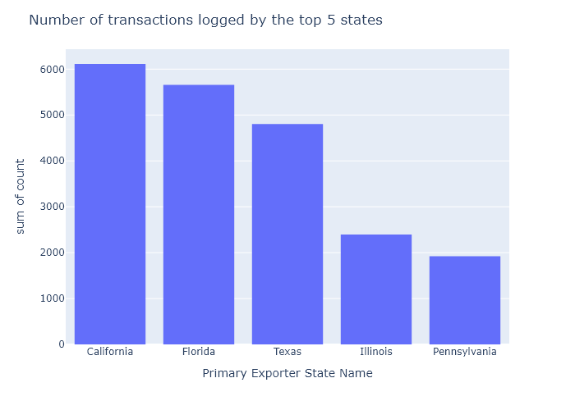
Count plot

Slide 15
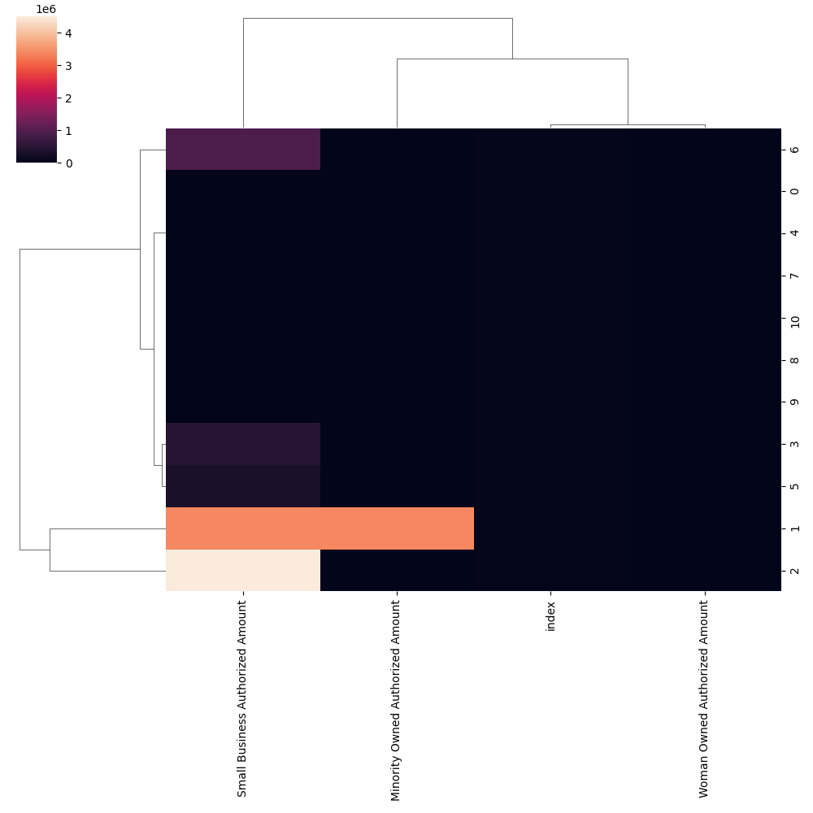
Cluster Map

Slide 16
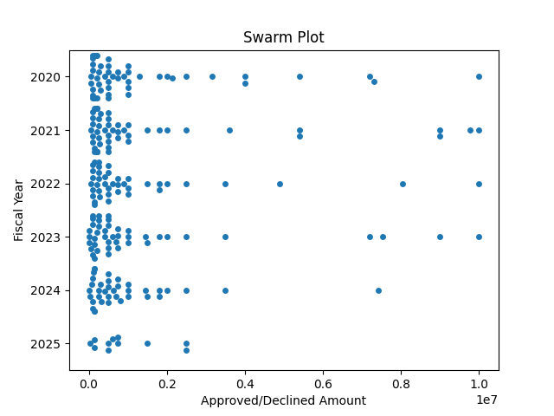
Swarm Plot

Slide 17
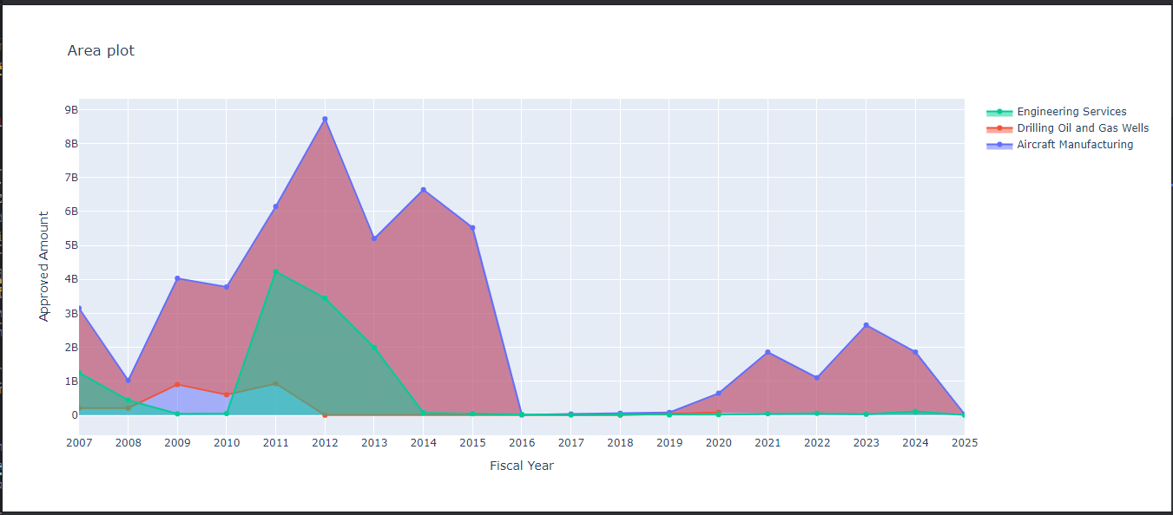
Area Plot

Slide 18
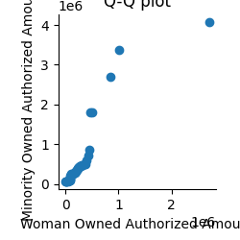
Q-Q Plot

Slide 19
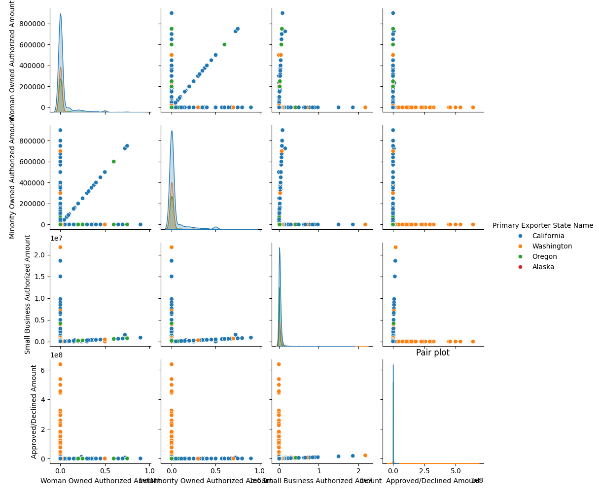
Pair plot

Slide 20
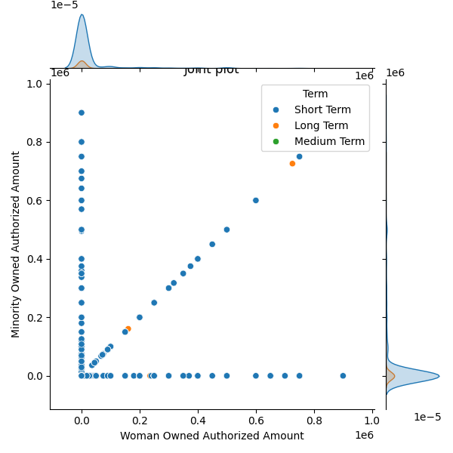
Joint Plot

Slide 21
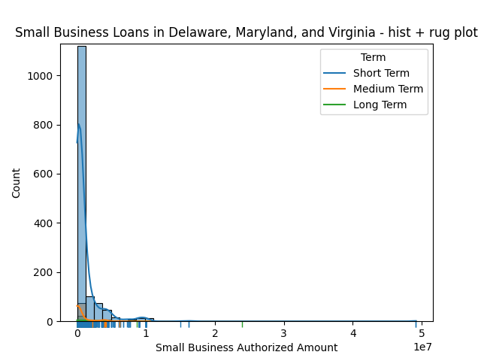
KDE and Rug Plots

Slide 22
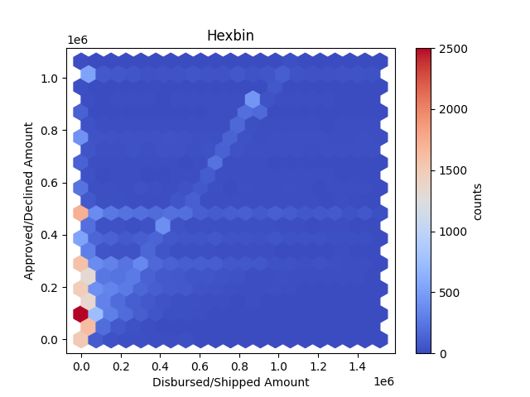
Hexbin

Slide 23
Dist Plot

Slide 24
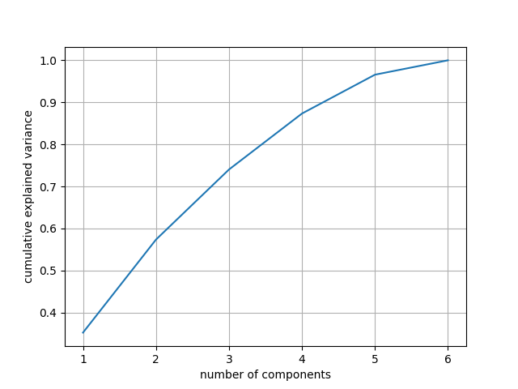
Principal Component Analysis
Condition number for original dataset: 3.209868653781116
Condition number for reduced feature dataset: 3.209868653781077

Slide 25
Normality test
Method: K-S test
Result: Numerical Data ('Approved/Declined Amount', 'Disbursed/Shipped Amount', 'Small Business Authorized Amount', 'Woman Owned Authorized Amount', 'Minority Owned Authorized Amount’) is not normally distributed

Slide 26
Part 2: Interactive Web App

Slide 27
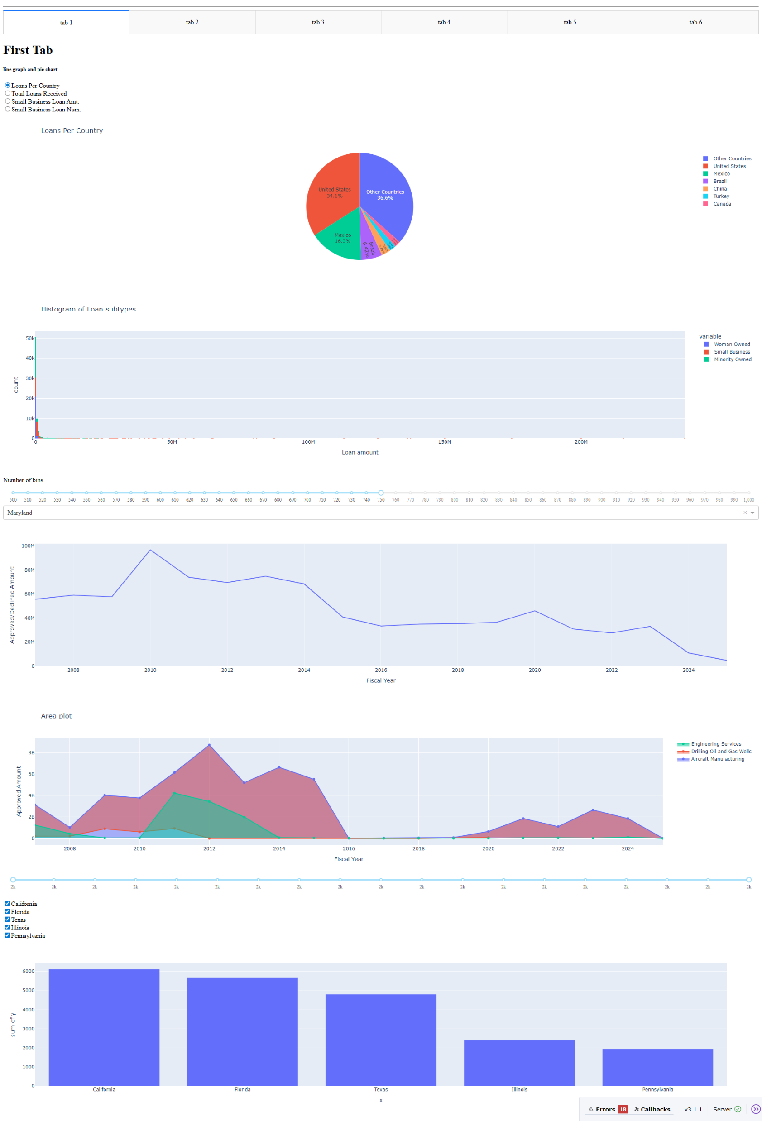
Interactive components
Examples:

Slide 28
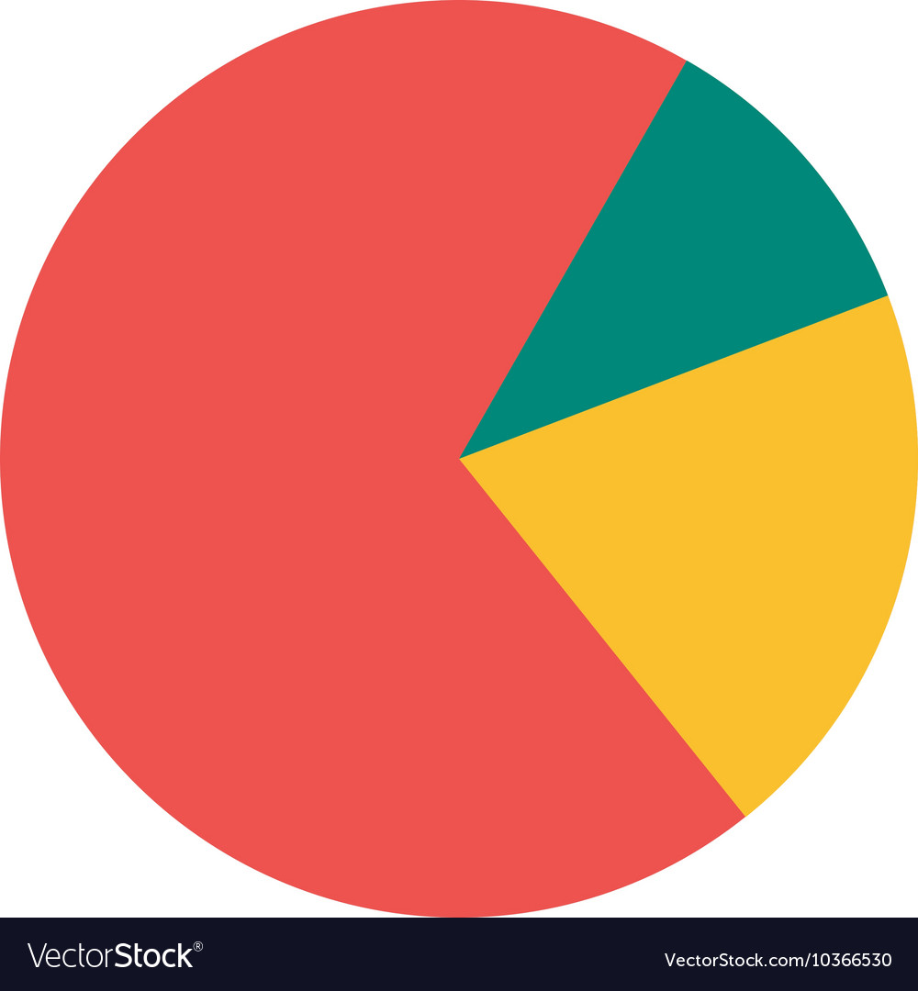
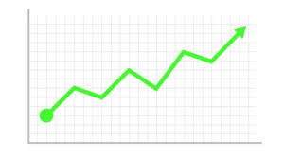
Interactive components (cont.)

Slide 29
Challenges
Difficult reproducing some graphs in Plotly due to deprecated packages
Difficult to run on my machine due to large dataset.
Difficulties running app on Google Cloud

